Slide 1
STUDENT NAME: Arunkumar. S
REGISTER NO AND NMID: D1A13DB12FCA0C09D184F132D27BA83B
DEPARTMENT: b.sc.computer science
COLLEGE: COLLEGE/ UNIVERSITY: Government arts college/Bharathiyar
University.

Slide 2
Project Title
Interactive portfolio using front end web development

Slide 3
Portfolio :
This portfolio reflects my technical expertise, creativity, and problem-solving ability. It showcases selected projects that combine functionality with design, demonstrating both technical skill and innovative thinking.

Slide 4


AGENDA
Problem Statement
Project Overview
End Users
Tools and Technologies
Portfolio design and Layout
Features and Functionality
Results and Screenshots
Conclusion
Github Link
3/21/2024 Annual Review

Slide 5

PROBLEM STATEMENT
The portfolio was developed to present my ability to design and implement practical, user-focused solutions in computer science. It illustrates my commitment to quality and continuous learning.

Slide 6

PROJECT OVERVIEW
The projects highlight my skills in development and design, emphasizing efficiency, usability, and innovation. Each work captures my approach to solving real-world problems with technical precision.

Slide 7

WHO ARE THE END USERS?
Employers
Academic evaluators
Industry collaborators

Slide 8
TOOLS AND TECHNIQUES
HTML, CSS, JavaScript, React, and design tools such as Figma.
Focus: responsive design, clean code, and interactive UI.

Slide 9
POTFOLIO DESIGN AND LAYOUT
Minimal, modern interface
Device-responsive layout
Smooth navigation and interactivity
Clear sections for skills and projects
‹#›

Slide 10
FEATURES AND FUNCTIONALITY
Responsive design for all devices
Simple, fast navigation
Optimized performance with clean code
Interactive project showcase
Clear presentation of skills and achievements

Slide 11
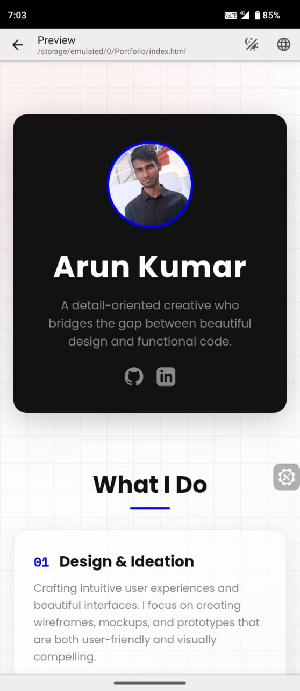
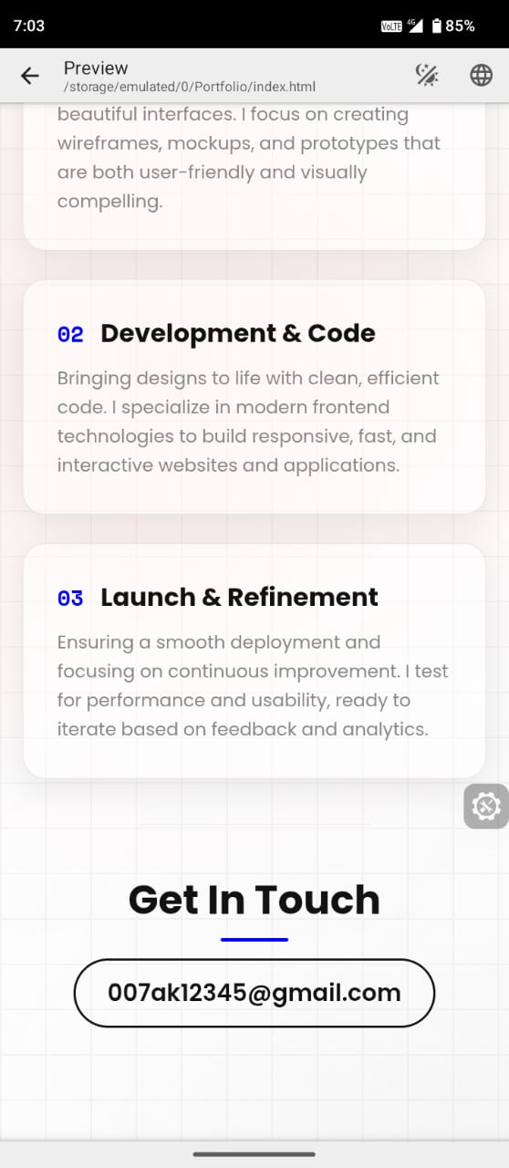

RESULTS AND SCREENSHOTS
3/21/2024 Annual Review
‹#›

Slide 12
CONCLUSION
This portfolio is a concise representation of my skills, creativity, and professional approach, providing stakeholders with a clear view of my capabilities and potential contributions.
‹#›

